Slide 1


Slide 2
The Results of 2014 Elections

Slide 3
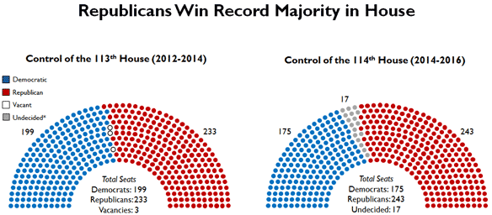

Slide 4
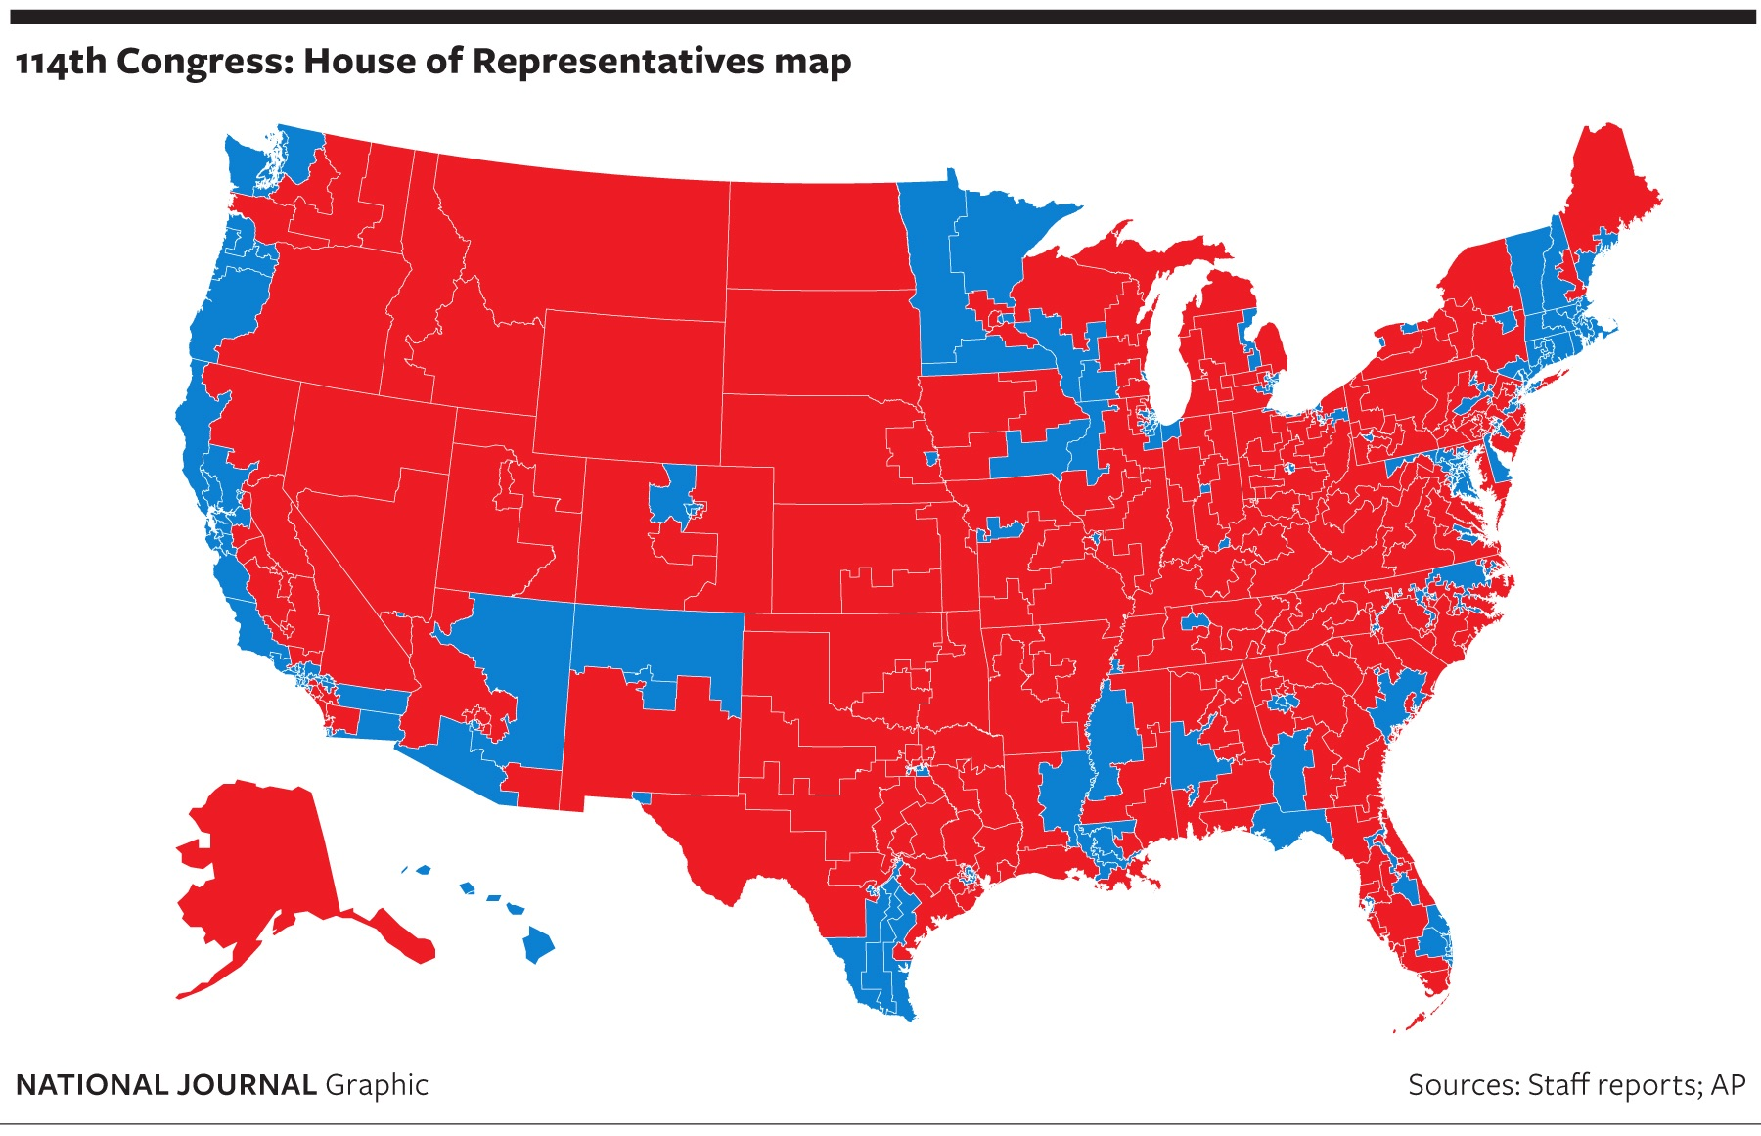

Slide 5
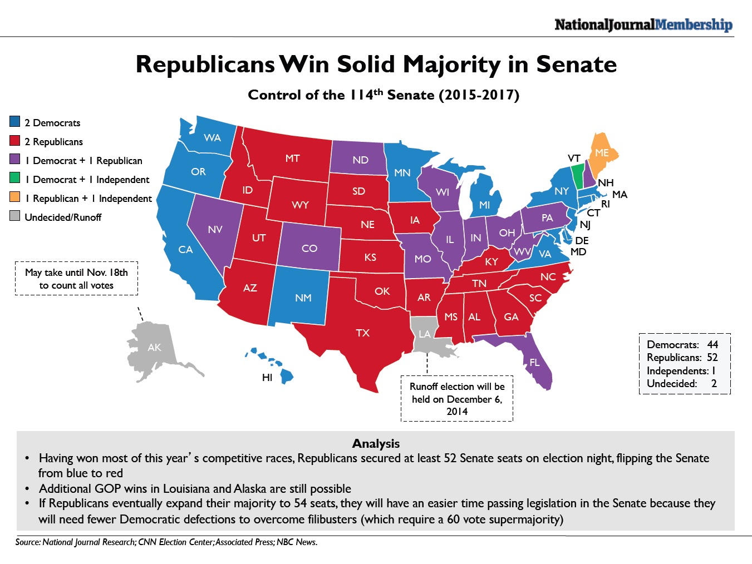

Slide 6
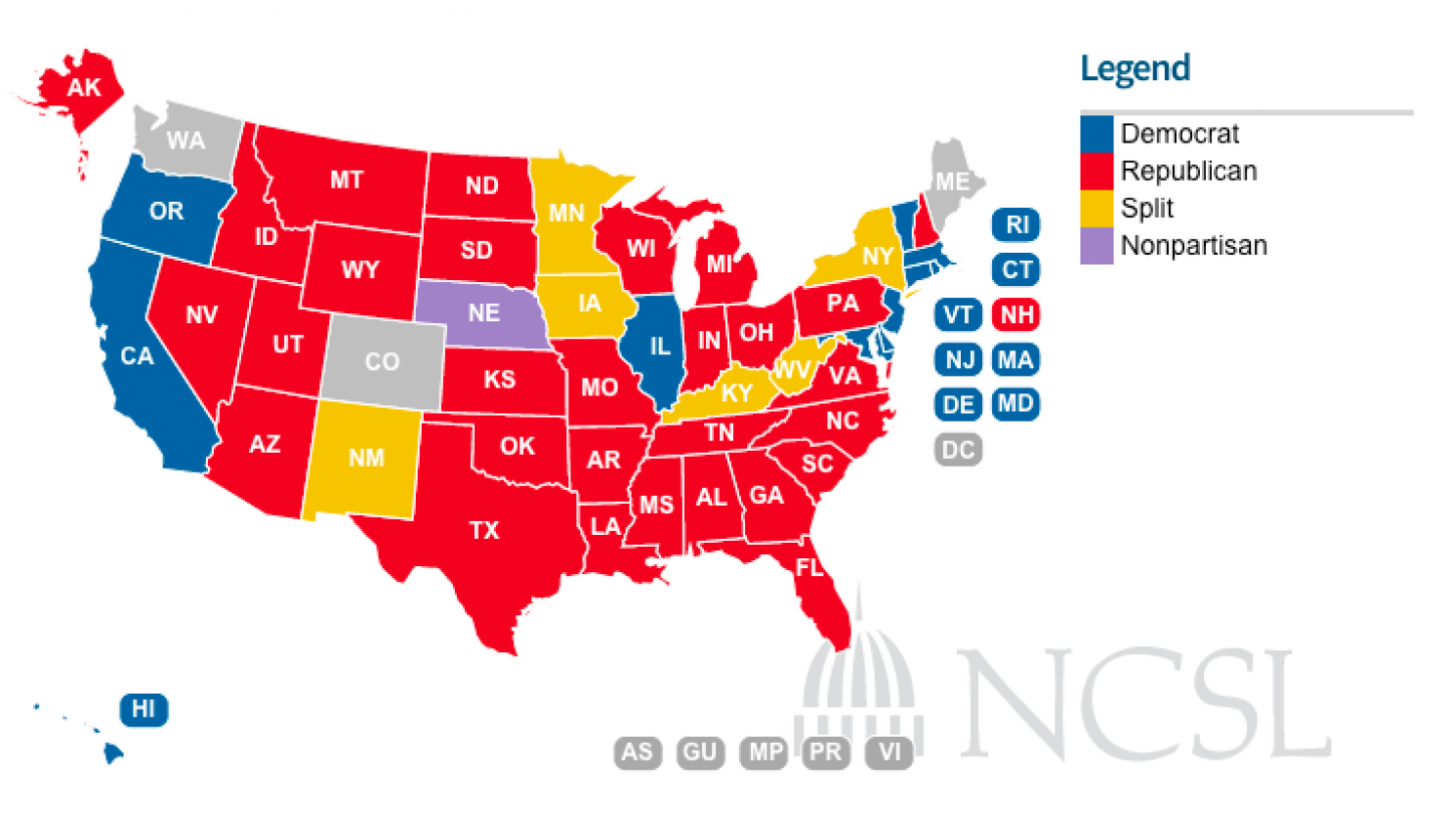
State Legislatures 2014
(next year GOP have even more)

Slide 7

What Do Americans Think of Canada?

Slide 8
They Don't

Slide 9
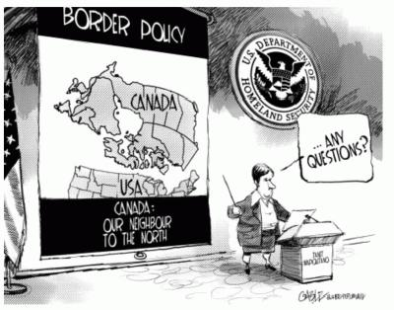
And What They Think They Know…
… isn’t always accurate

Slide 10
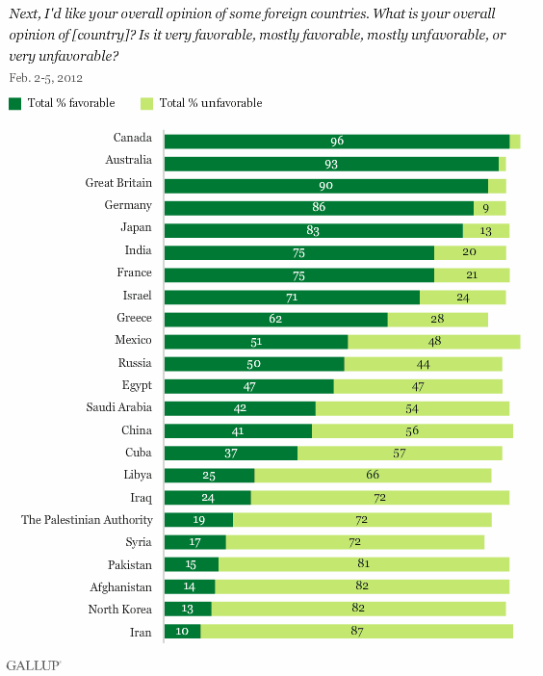
But they like us

Slide 11
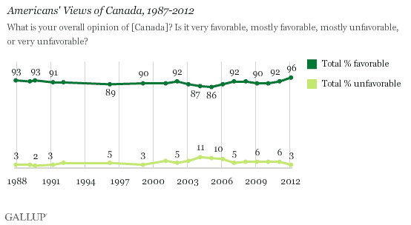
And always have…
Notes:
http://www.gallup.com/poll/161159/americans-least-favorable-toward-iran.aspx

Slide 12
Who’s Who

Slide 13
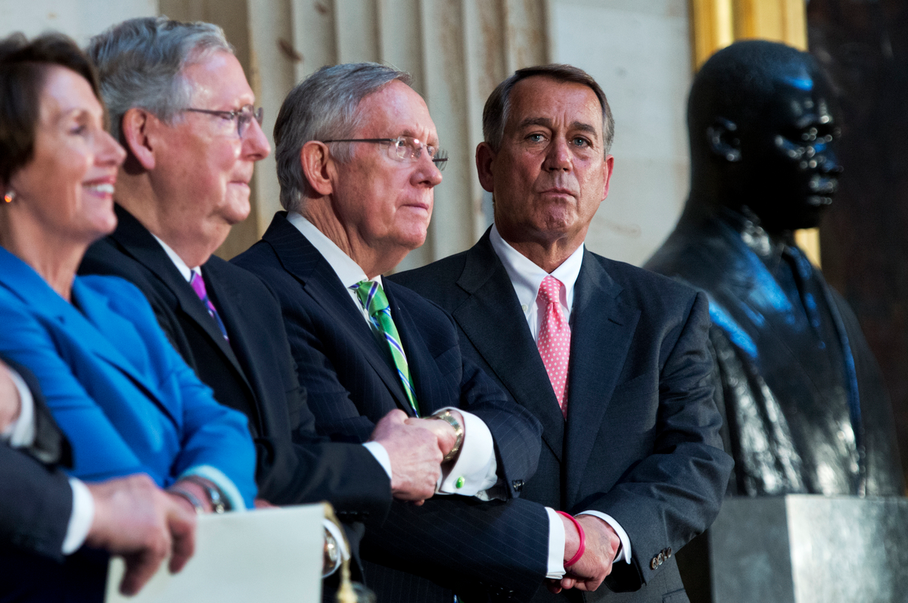
Congressional Leadership

Slide 14
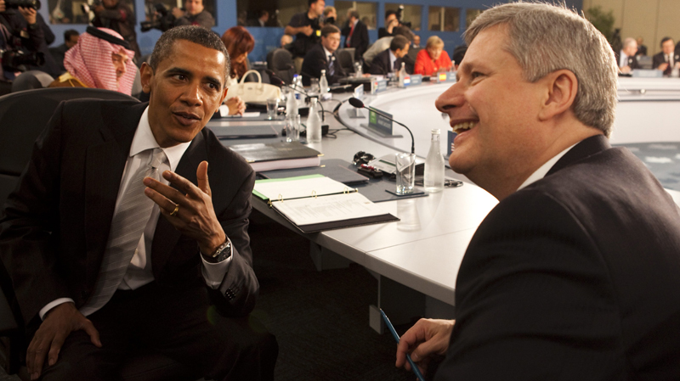
Personal relationship between the leaders counts

Slide 15
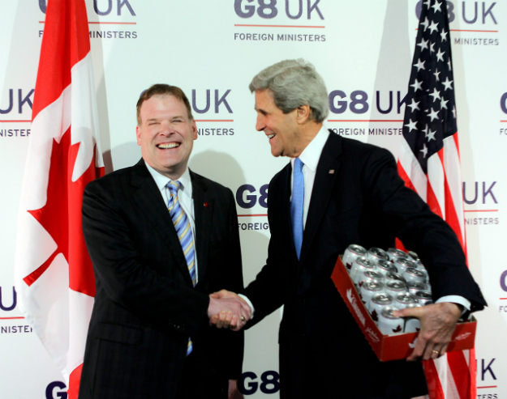
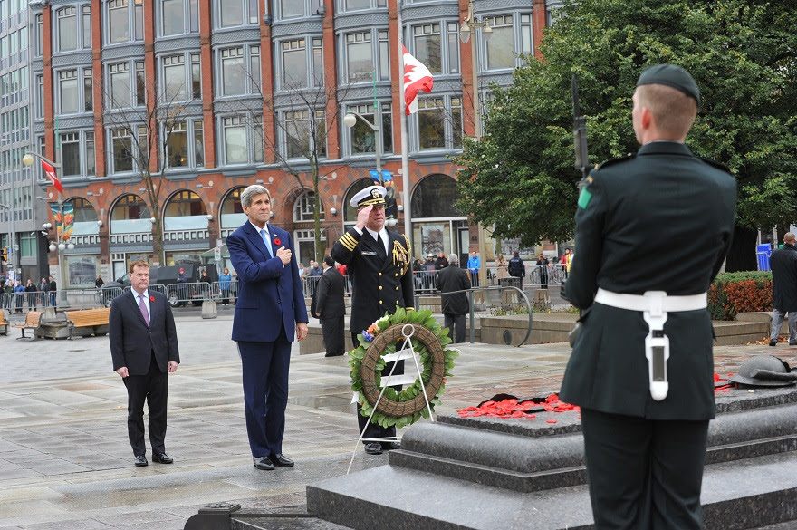
Foreign Ministers
Notes:
http://thecable.foreignpolicy.com/posts/2013/04/11/kerry_wins_a_case_of_beer_from_canada

Slide 16
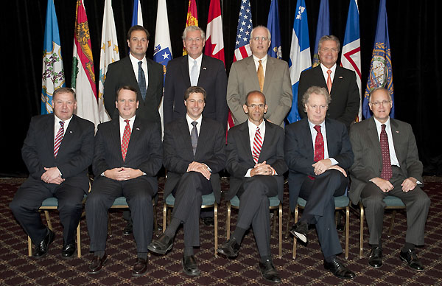
Premiers and Governors

Slide 17
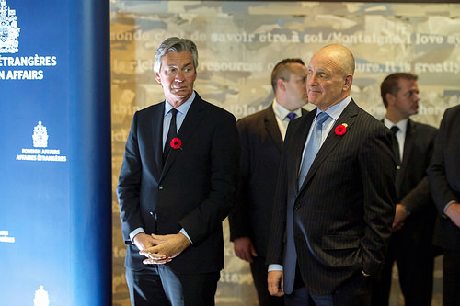
The Ambassadors

Slide 18
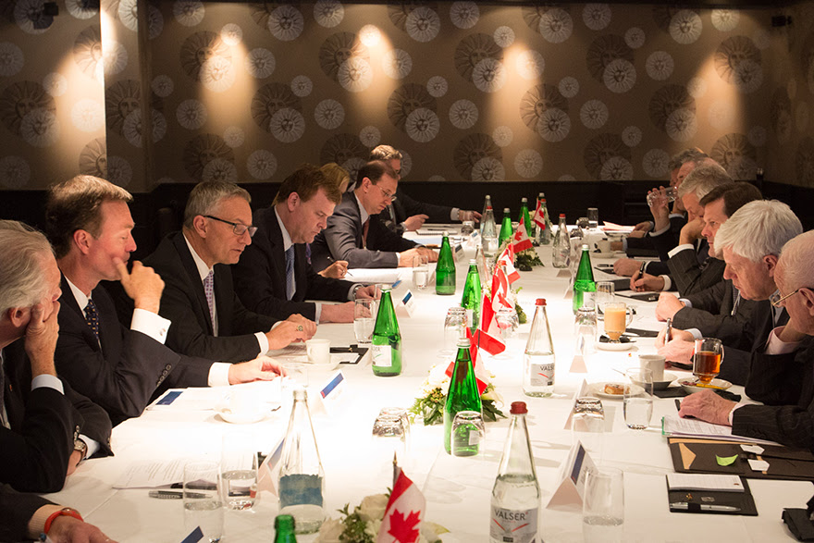
Business

Slide 19
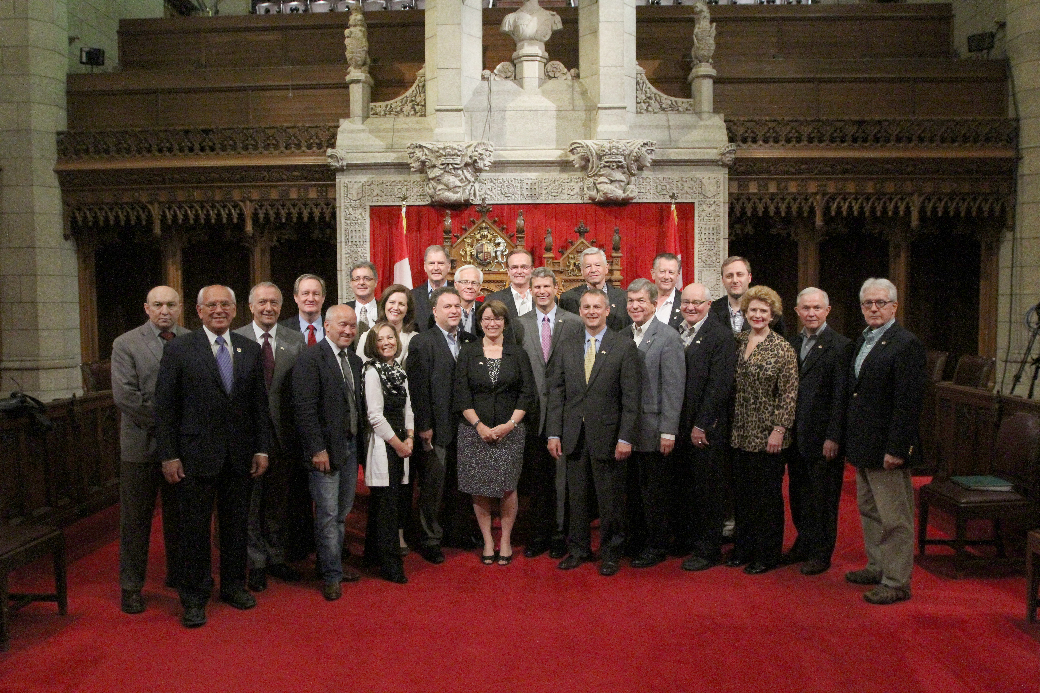
Legislators

Slide 20
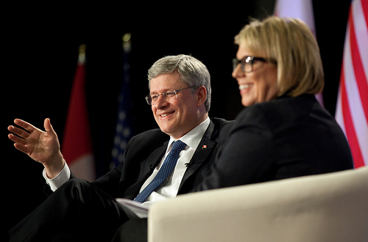
Trans-Border Associations

Slide 21
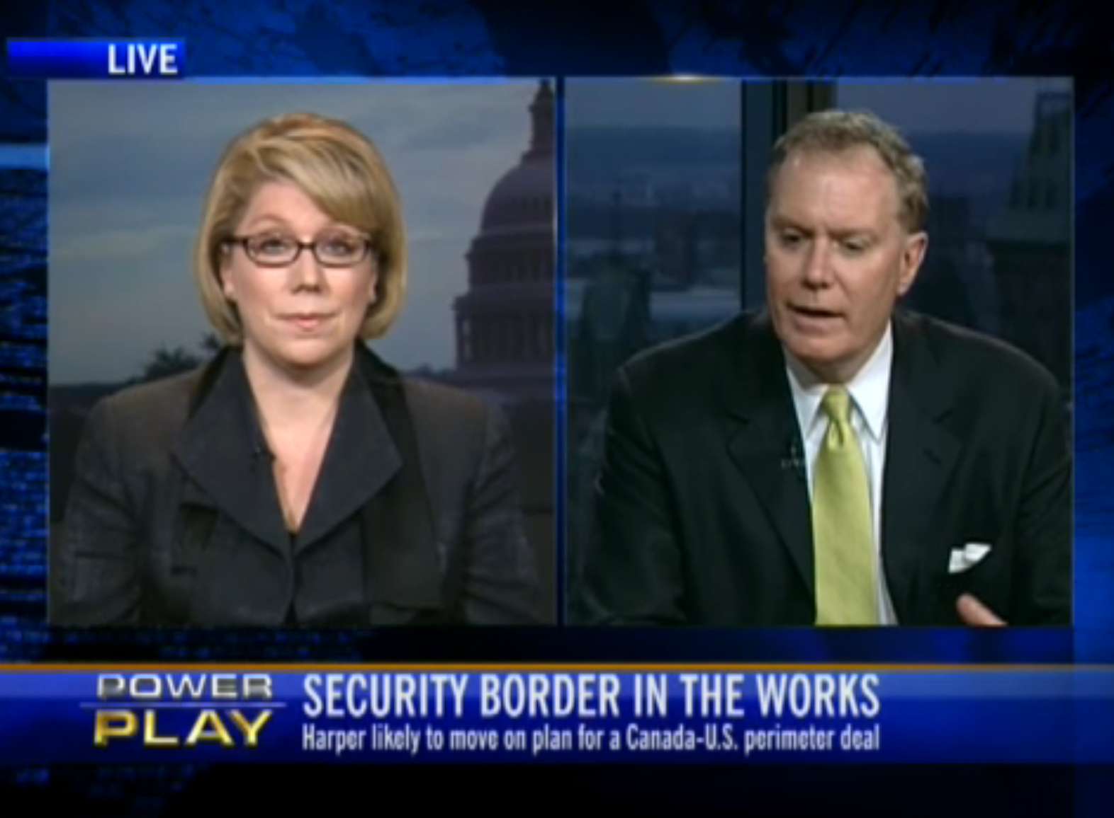
The Chattering Class

Slide 22

Just folks

Slide 23
Canada-USA
Just the Facts

Slide 24
Over 8 million U.S. jobs depend on trade and investment with Canada
Canada is the top export destination for 38 states
Canada is the U.S.'s largest customer purchasing $233 billion worth of goods in 2012 - more than China, Japan and the U.K. combined
Source: Canadian Embassy in Washington
Notes:
http://can-am.gc.ca/relations/commercial_relations_commerciales.aspx?lang=eng

Slide 25
Canadian-owned companies in 17,000 locations across the U.S. employ more than 619,000 Americans
Canada is the United States’ largest and most secure supplier of energy: oil, natural gas, electricity and nuclear fuel
400,000 people cross the Canada–U.S. border daily
Source: Canadian Embassy in Washington
Notes:
http://can-am.gc.ca/relations/commercial_relations_commerciales.aspx?lang=eng

Slide 26
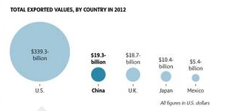
Canadian Trade Partners
Notes:
http://www.theglobeandmail.com/report-on-business/international-business/canadian-exports-to-china-and-other-top-markets/article8904890/?from=8903142

Slide 27
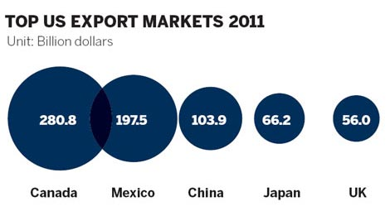
US Trade Partners

Slide 28
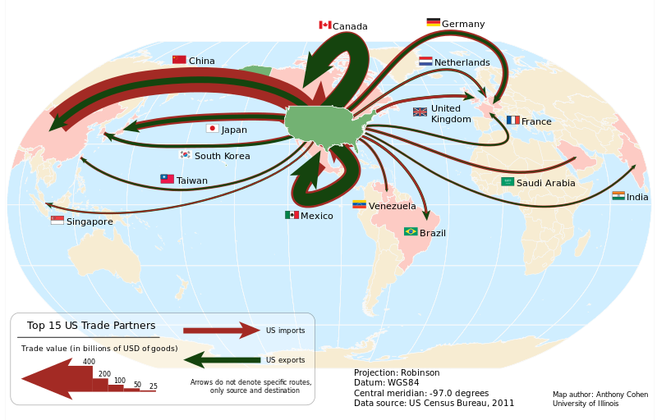
US Trading partners

Slide 29
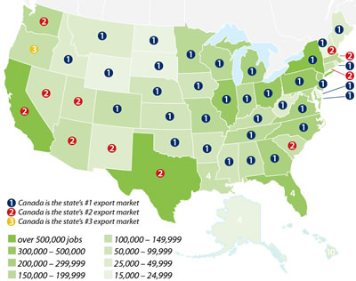

Slide 30
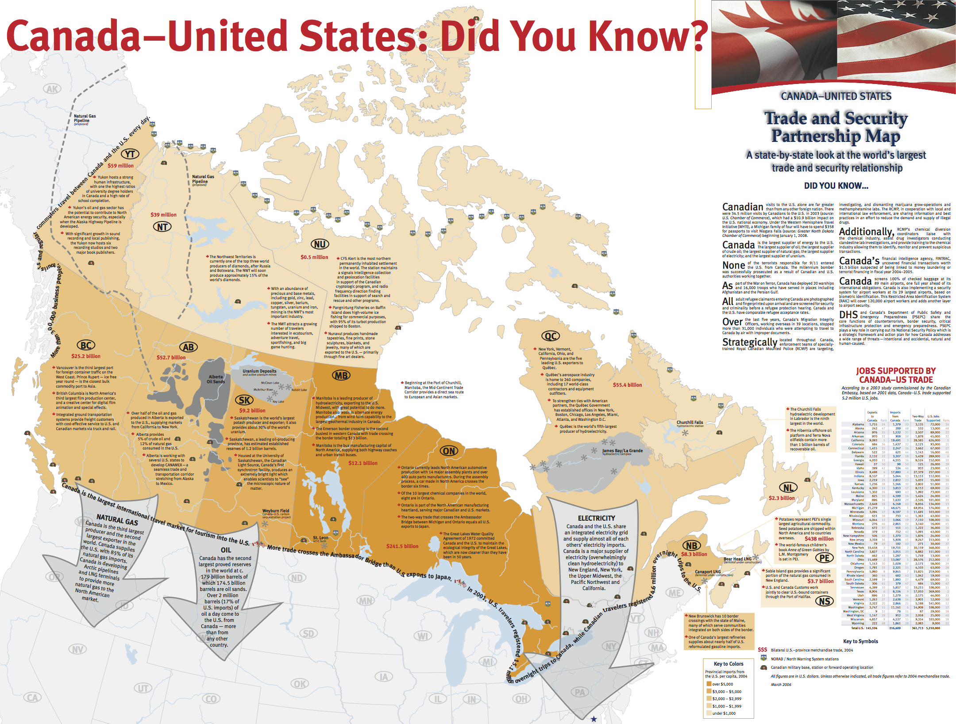

Slide 31
The Issues: Bilateral

Slide 32
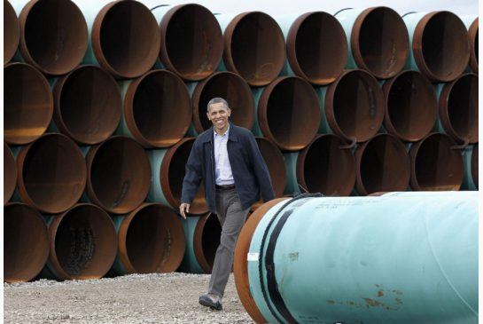
The Pipeline
“I have to constantly push back against this idea that somehow the Keystone pipeline is either this massive jobs bill for the United States or is somehow lowering gas prices.
Understand what this project is: It is providing the ability of Canada to pump their oil, send it through our land down to the Gulf where it will be sold everywhere.”
President Obama November 2014

Slide 33
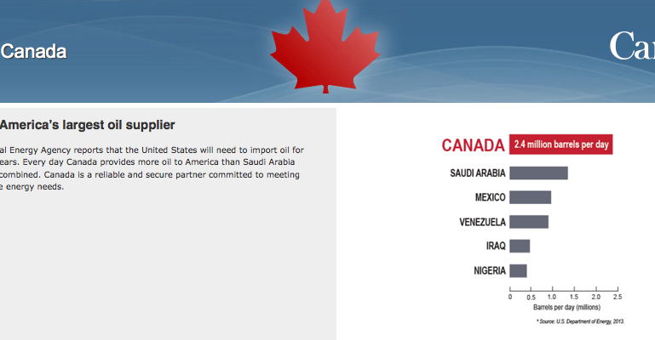
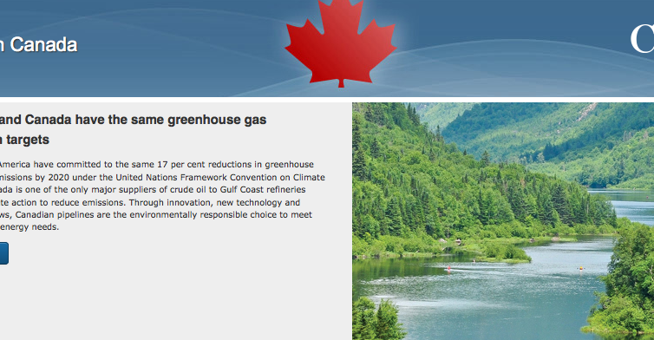
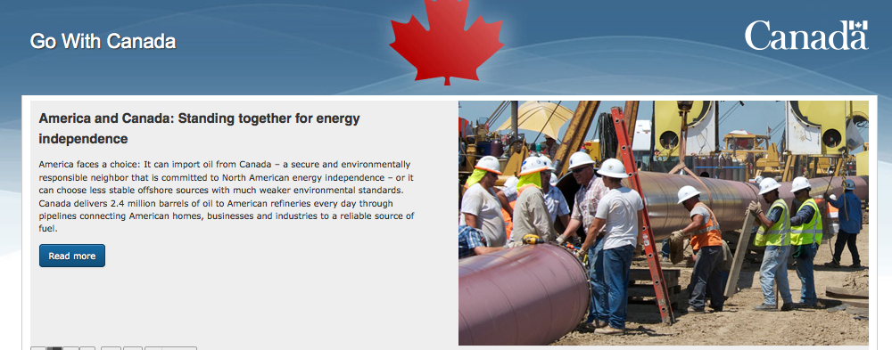
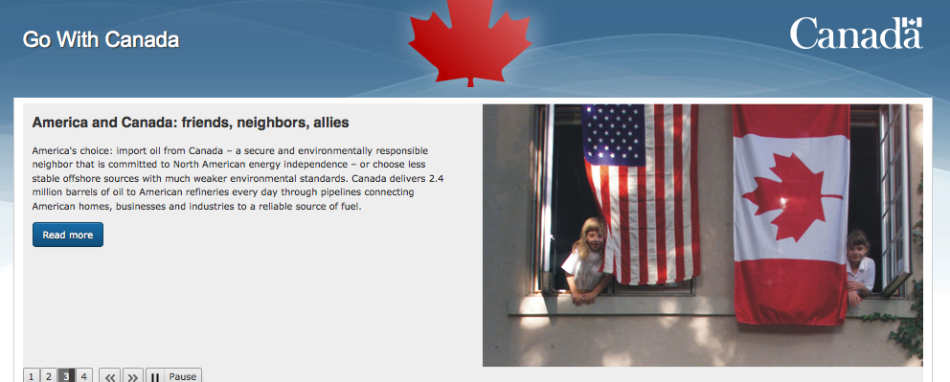
www.gowithcanada.ca

Slide 34
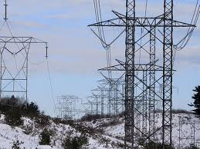
Transmission Lines South
There is a predominantly north-south pattern to Canada’s transmission high voltage lines.
Manitoba Hydro is seeking approval for a Great Northern Transmission line to link with Minnesota
Quebec Hydro wants the Northern Pass Interconnection through New Hampshire’s White Mountains

Slide 35
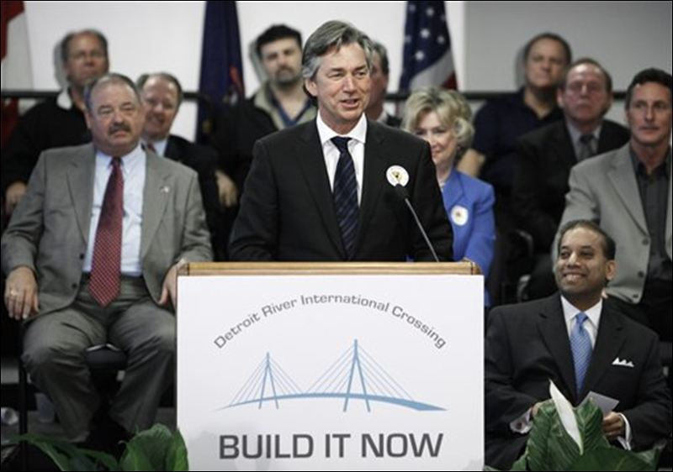
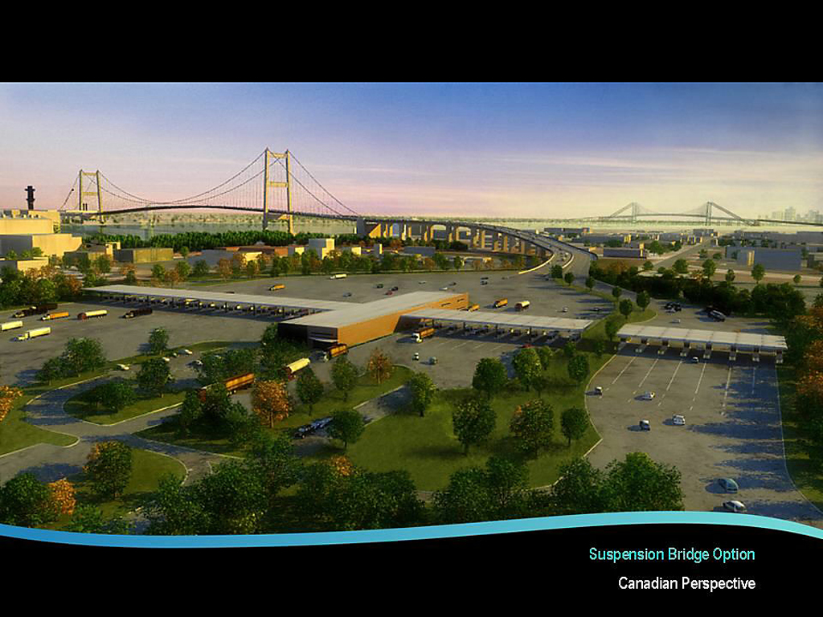
The Bridge

Slide 36
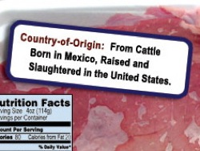
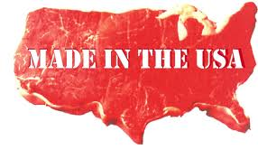
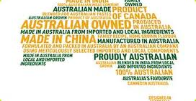
COOL: What’s in a label
Canada-U.S. trade war is looming as Ottawa threatens "retaliatory measures" against the United States in a continuing dispute over meat labeling.
Labels will include such information as "born, raised and slaughtered in the United States" for American meat. Cuts of meat from other countries could carry labels such as "born in Canada, raised and slaughtered in the United States.”
Notes:
http://www.ctvnews.ca/canada/ottawa-threatens-retaliatory-measures-over-new-u-s-meat-labelling-regulations-1.1293841

Slide 37
The Issues: Multilateral

Slide 38
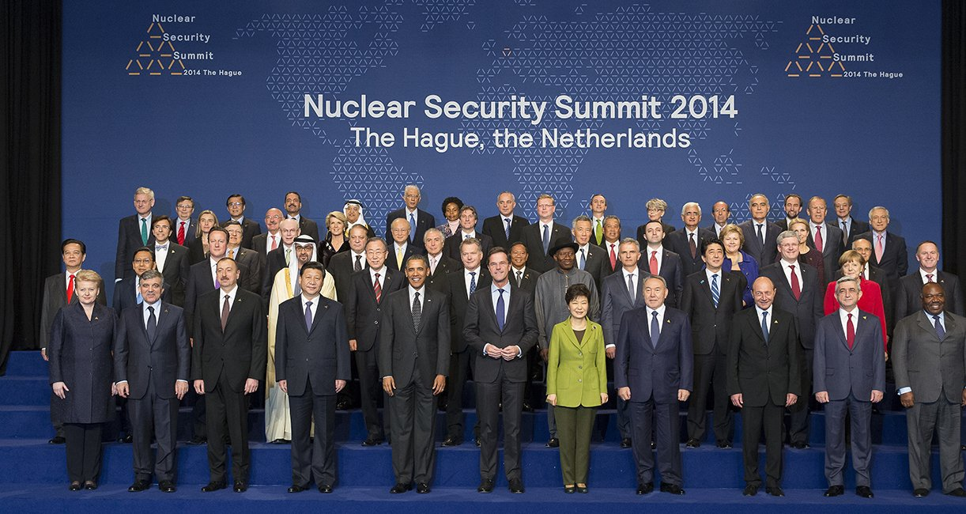
Minding the World
The United States, by far the most powerful NATO member, has drastically cut back its European forces from a decade ago.
European countries, which have always lagged far behind the United States in military might, have struggled and largely failed to come up with additional military spending at a time of economic anemia and budget cuts.

Slide 39

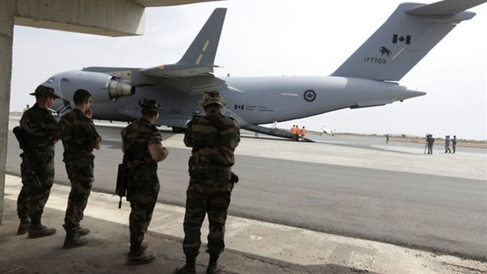
Fighting ISIL
In coordination with the US and allies and with Iraq, Canada is taking action to protect innocent civilians and counter ISIL’s “barbaric activities and expansionist agenda, which pose a very real threat to regional and global security.”
PM Harper September 2014

Slide 40
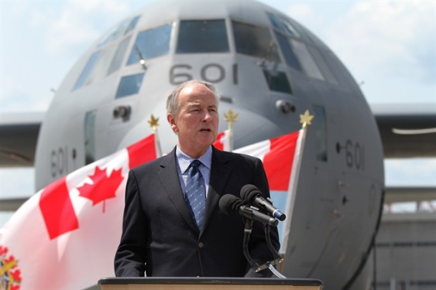
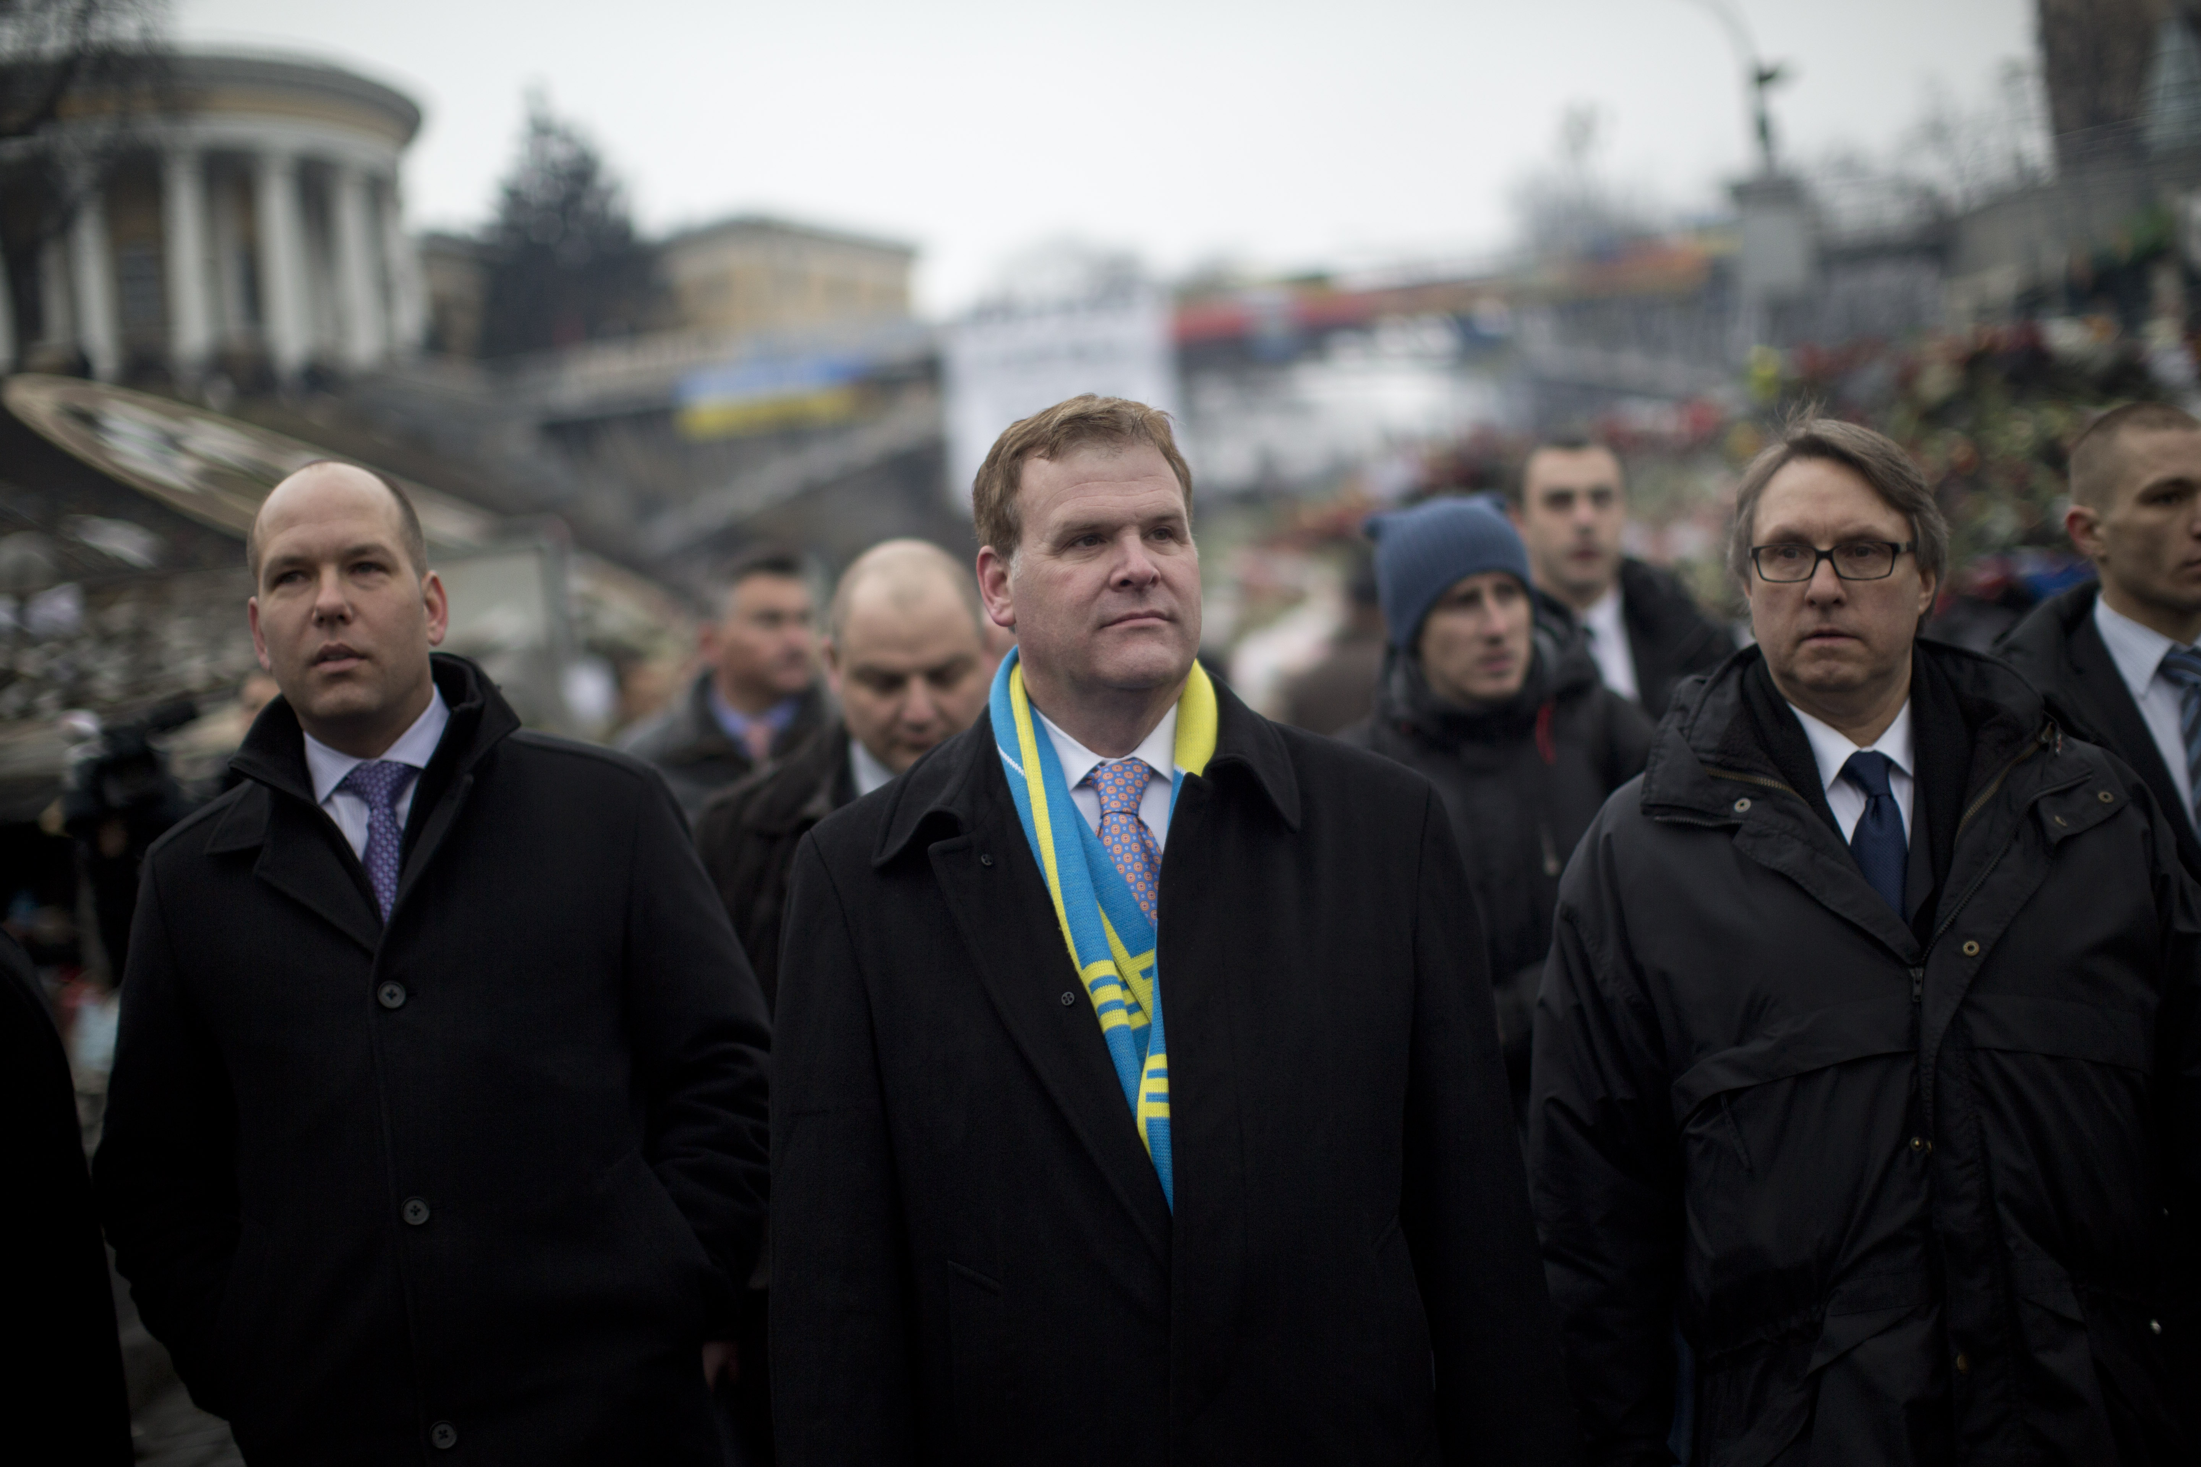
Ukraine
Canada has sent non-lethal military equipment to Ukraine
Canadian Forces CF-18 are now positioned in Eastern Europe - HMCS Toronto is in the Black Sea leading NATO Task Force
Canada and NATO Allies have imposed sanctions on Russians and trade in energy, defence, banking

Slide 41
Our North American
Neighbourhood

Slide 42
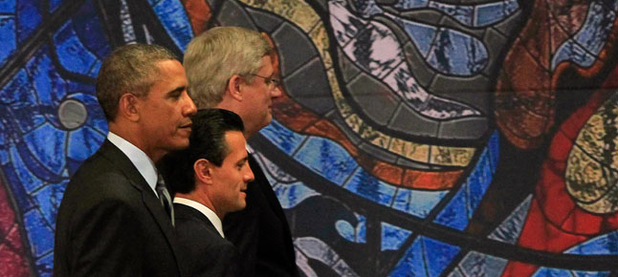
NAFTA at 20
Fourfold growth in trilateral trade over the last 20 years that now exceeds a trillion dollars
Problems: the friction between Harper and Obama over the Keystone XL pipeline: Peña Nieto's annoyance with Obama's failure to deliver promised immigration reform and his frustration with Harper for refusing to lift the controversial visa restrictions on Mexicans entering Canada.
Next steps: Border, Trusted Traveller, Energy, Transportation

Slide 43
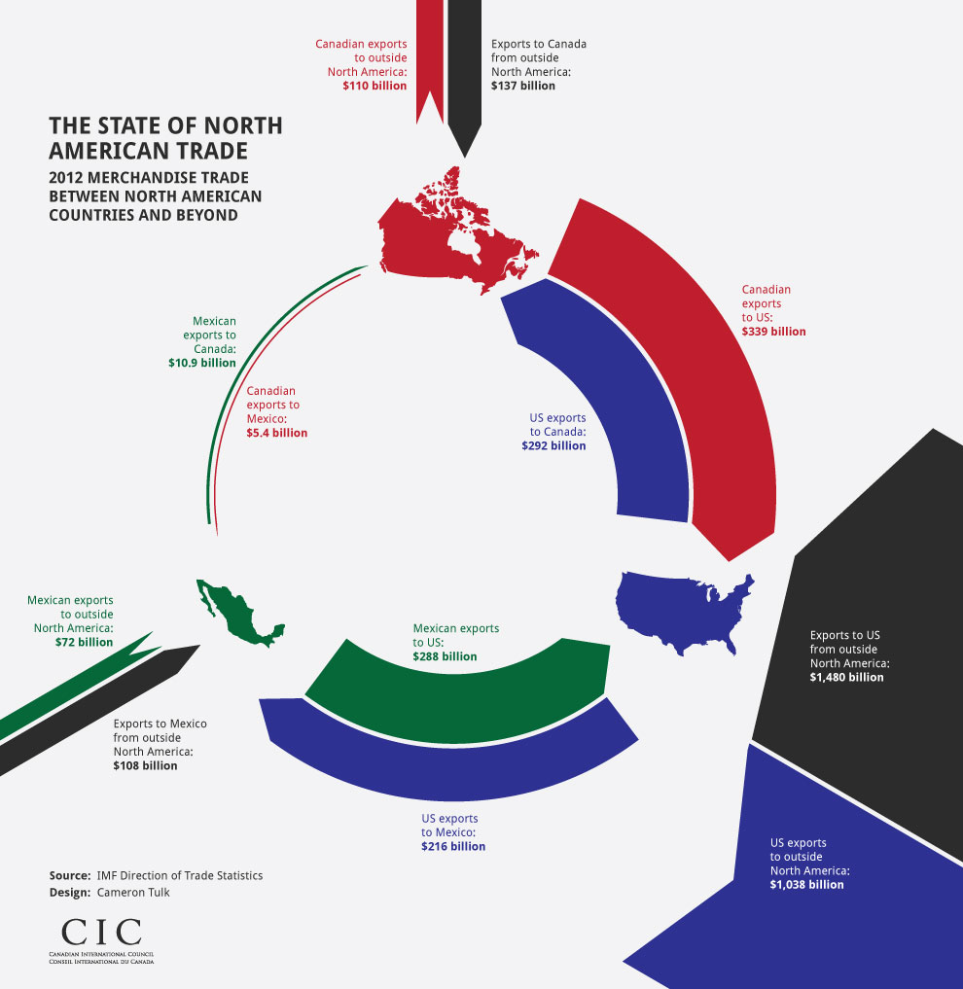

Slide 44


Slide 45
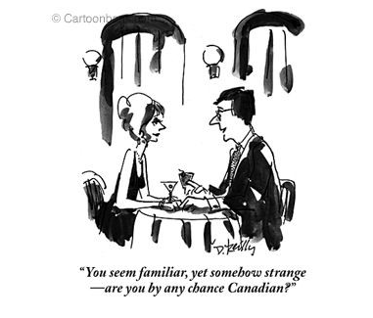
Notes:
"You seem familiar, yet somehow strange -- are you - by any chance Canadian?"
"You seem familiar, yet somehow strange—are you by any chance Canadian?"
(Man talking to woman over drinks.)
Published in The New Yorker 11/19/2001
by Donald Reilly

