Slide 1
Wind Energy: Diversifying Canada’s Electricity Markets
Robert Hornung, CanWEA
Carleton Sustainable Energy Speaker Series
September 30, 2014

Slide 2
CanWEA
National association of companies with an interest in the Canadian wind energy market
Almost 300 members representing wind energy project developers, owners and operators, wind turbine manufacturers and components suppliers; and a range of service providers to the industry
Our mission is to support the responsible and sustainable growth of wind energy in Canada

Slide 3
Presentation Outline
An Update on Wind Energy in Canada Today
Why Wind Energy Will Play a Central Role in Canada’s Future Electricity Supply
Barriers to Capturing Canada’s Wind Energy Potential
Canada’s Wind Energy Future

Slide 4
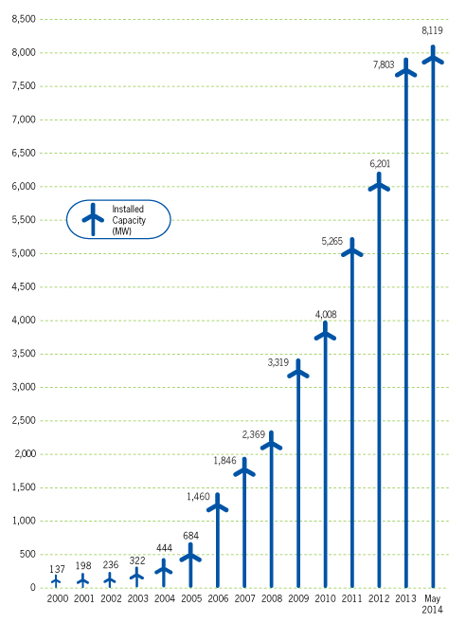
Historic Growth in Canada’s Installed Wind Energy Capacity

Slide 5
Wind Energy in Canada Today
Canada is the 9th largest wind energy producer in the world and has 8,517 MW of installed capacity today
Canada has been a stable and steady market averaging 1,100 MW of new installations / year for the last 5 years
Canada installed a record 1,600 MW of new wind energy capacity in 2013, ranking Canada 5th globally for new installations

Slide 6
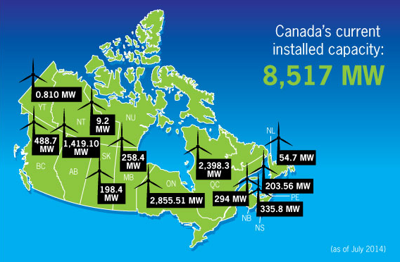
Wind Energy Across Canada

Slide 7
Wind Energy’s Contribution to Canada’s Electricity Production
Wind energy now meets almost 4% of Canada’s electricity demand (equal to more than 2.5 million homes annually)
Wind energy’s contribution to provincial electricity needs
BC 1.51% QC 2.63%
AB 3.89% NB 4.02%
SK 3.11% NS 8.75%
MB 2.73% PEI 37.01%
ON 3.70% NF 3.18%

Slide 8
Wind Energy’s Short-Term Prospects
2014 is projected to set a new record with over 1,600 MW of new installed capacity
Projects under construction and / or already contracted to be built should see Canada reach 12,000 MW of installed capacity by the end of 2016

Slide 9
Can Canada Go Further? Absolutely.
Wind energy as a percentage of domestic electricity demand in countries around the world and in the US
Denmark 34%
Portugal 23%
Spain 21%
Ireland 20%
Romania 14%
Germany 12%

Slide 10
Should Canada Go Further? Absolutely.
All forms of electricity generation, including wind energy, have their strengths and weaknesses
No form of electricity generation, however, is better positioned to meet the multiple needs of future electricity systems than wind energy

Slide 11
Canada’s Future Electricity System Needs
Canada’s electricity systems will continue to be asked to meet a mix of potentially competing objectives going forward:
Minimize costs for electricity consumers
Minimize the environmental impacts of electricity generation
Maximize the economic benefits of electricity generation
Ensure reliable delivery of electricity to consumers
Ensure social license for electricity generation, transmission, distribution and management

Slide 12
But……The Context Has Changed
Electricity systems around the world are being fundamentally challenged and transformed by:
Massive growth in distributed electricity generation
Introduction of multiple new electricity generating technologies (some of them are variable generation resources)
New technologies to manage electricity demand
These are disruptive changes like the introduction of cellphones, television on the internet, etc.
Such changes challenge the existing order and require significant innovation in policy and market frameworks to facilitate the smoothest possible transition

Slide 13
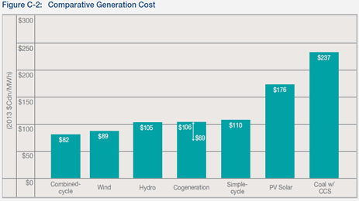
Can Wind Energy Help Minimize Costs for Electricity Consumers?
Source: AESO 2014 Long-Term Outlook
Wind energy is a cost-competitive form of new electricity generation. It has no fuel cost and is not subject to commodity and carbon price risks. Wind energy is also scalable – better able to match changes in demand.

Slide 14
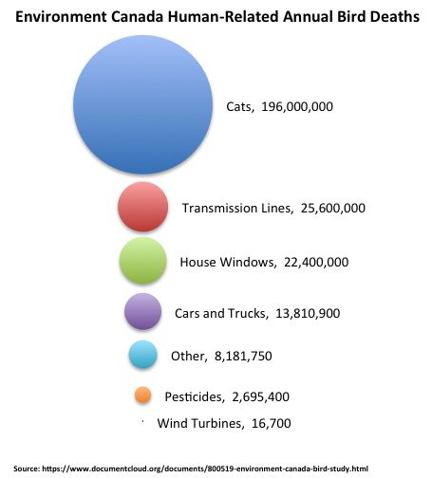
Can Wind Energy Help Minimize the Environmental Impacts of Electricity Generation?
Wind energy produces no GHG emissions, air pollution, water pollution or toxic / hazardous / nuclear wastes when generating electricity
Wind energy does have environmental impacts and they must be minimized (but also placed in context)

Slide 15
Can Wind Energy Deliver Economic Benefits?
In 2013, wind energy projects in Canada represented $3.5 billion in investment
Wind energy projects provide a new revenue stream for local communities (land lease income, municipal tax revenues, community benefit agreements)
Wind energy creates a significant amount of construction jobs, manufacturing jobs in the supply chain, and a smaller amount of operations and maintenance jobs (there are 5,000 workers in the Quebec wind energy industry today)

Slide 16
Can Wind Energy Be a Reliable Source of Electricity Generation?
Most grids can integrate 10% wind energy with no significant changes required to the system – many tools exist to allow for further wind energy penetration
Increase flexibility of existing generation and load
Improve wind plant output forecasting tools
Improve geographic distribution of wind plants
Improve cooperation/Area Control Error(ACE) sharing
Improve Day Ahead, Hour Ahead and Real Time markets
Improve and increase investment in adequate transmission

Slide 17
Social License
Wind energy continues to have strong general public support in all regions of Canada
Wind energy, however, cannot assume such support at the community level – it must be earned and CanWEA produced the wind energy industry’s first Best Practices for Community Engagement and Public Consultation
Developers are establishing innovative ways to provide economic benefits and support community partnerships
Community Liaison Committees are being established in order to create a foundation for meaningful dialogue
Future competitive procurement processes will enhance early consultation opportunities.

Slide 18
Understanding and Responding to Public Questions / Concerns
Wind energy is still relatively new to Canada, and many Canadians naturally have questions about wind energy in the areas we have discussed and in many other areas as well (e.g., property values, health, bats, visual impacts)
One way CanWEA has attempted to respond to this is through www.windfacts.ca

Slide 19
Will Canada Go Further?
There is no “Canadian” wind energy market
Canada is made up of 13 different wind energy markets – a more complex working environment for the industry than the European Union
Wind energy, and the electricity sector in general, remain policy driven industries - whether or not Canada will go further will depend on policy decisions taken at the provincial level

Slide 20
Ontario
Projections for limited growth in future electricity demand and Ontario’s LTEP envisions very little need for new electricity generation
Ontario’s LTEP does make choices, however, stating that new generation will be provided by renewable energy (e.g., 600+ MW of new wind energy) – no plans to invest in new nuclear or natural gas generation
Additional growth for wind energy in the province dependent on future growth in electricity demand and ultimate decisions made with respect to nuclear refurbishment

Slide 21
Quebec
Projections for limited growth in future electricity demand and little need for new generation
Currently seeking to complete one major new hydro project (La Romaine) and 800 MW of new wind energy
Quebec will develop a new Energy Strategy in 2015 – a key consideration will be the future of Quebec’s robust wind energy supply chain
Key question to be answered: Is an electricity surplus a burden or an opportunity? We believe it represent an opportunity to support new industry, electrification and electricity exports

Slide 22
Alberta
Alberta envisions strong growth in electricity demand, but Alberta’s unique merchant market makes it very challenging for wind energy to help fill the gap:
Provides no revenue certainty for generators – very challenging to secure financing for a capital intensive industry where most costs are upfront
Alberta’s new Premier has stressed the need to address GHG emissions and accelerate the phase out of coal fired generation – Alberta can only do this with wind energy
Alberta committed to developing a new Alternative and Renewable Energy Strategy in 2015

Slide 23
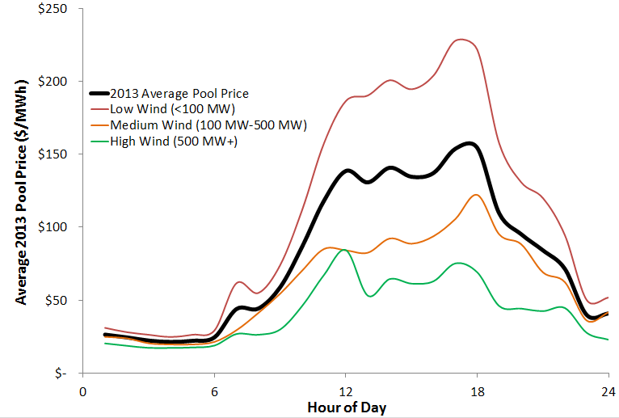
Good for Consumers, Tough for Wind Owners
Calculated from AESO 2013 Market Stats Data File

Slide 24
British Columbia
BC has significant potential for growth in electricity demand (e.g., LNG), but currently a high level of uncertainty around future demand levels
If demand is there, wind energy is a cost-competitive alternative for new generation
The scope of the wind energy opportunity will depend upon:
BC Government decision to proceed / not proceed with the Site C dam
BC Government concern / lack of concern about increasing GHG emissions in the electricity sector from natural gas

Slide 25
Canada’s Wind Energy Future
Canada has enormous untapped wind energy potential
When there is a need for new electricity supply, wind energy is well positioned to be a provider of choice
CanWEA believes Canada should move to secure 20% of its electricity from wind energy

Slide 26
Questions?

