Slide 1
AFRI 3100/5100
African Studies Abroad
Ghana, May 4-22, 2015
Prof. Chris Brown

Slide 2
Overview
Ghana
Preliminary Course Outline
Possible Contributors
Logistics & Budget
Application Process

Slide 3
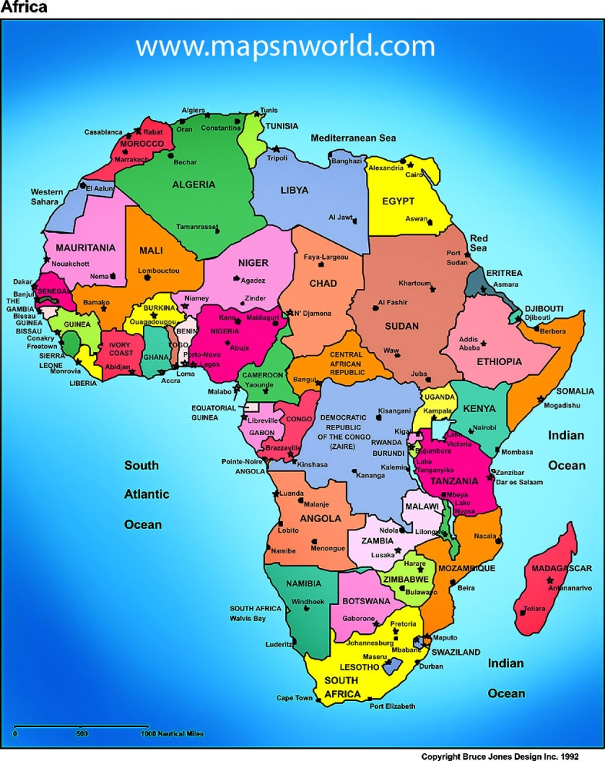
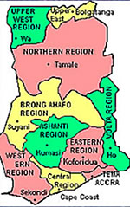
Ghana
Some maps:

Slide 4
Ghana
Politically and economically, always an African leader:
  First Independent country Sub-Saharan Africa, 1957
  Founding President, Kwame Nkrumah, major Pan-Africanist thinker
  First coup, 1966, spells “End of an Illusion” about politics in Independent Africa and ushers in period of economic decline and political instability
  In 1980s, under military leader Jerry Rawlings, becomes darling of World Bank for embrace of structural adjustment
  In 1992, among African leaders in return to democracy
  Today:
    Usually regarded as amongst most stable democracies in Africa
    High growth, and discovery of oil, lead to “middle-income” status
    But problems remain, both in consolidating democracy and addressing enduring poverty and inequality

Slide 5
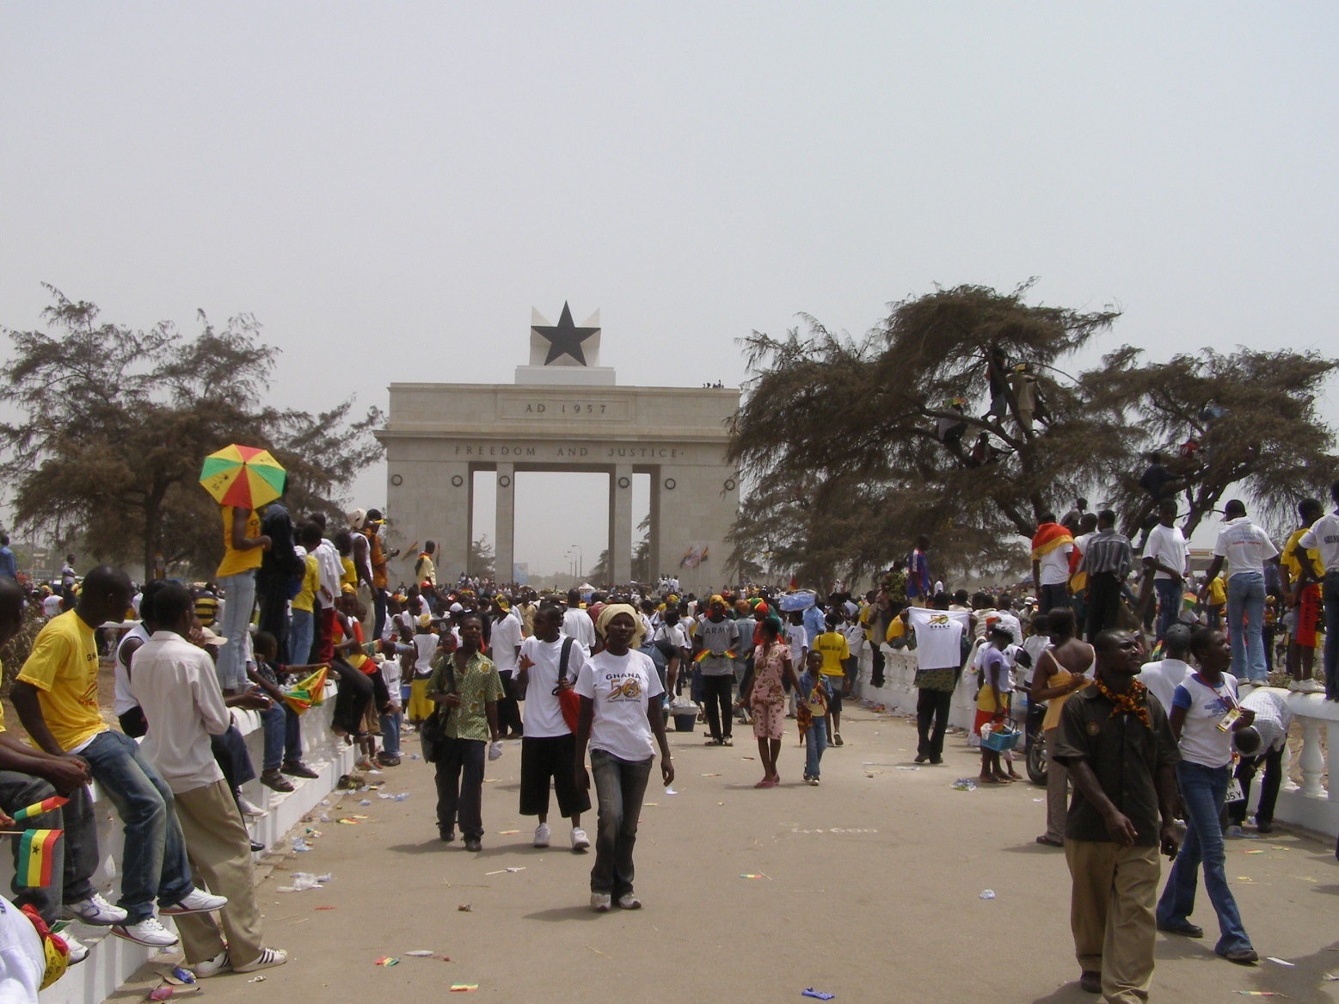
Independence Day, 50 year later

Slide 6
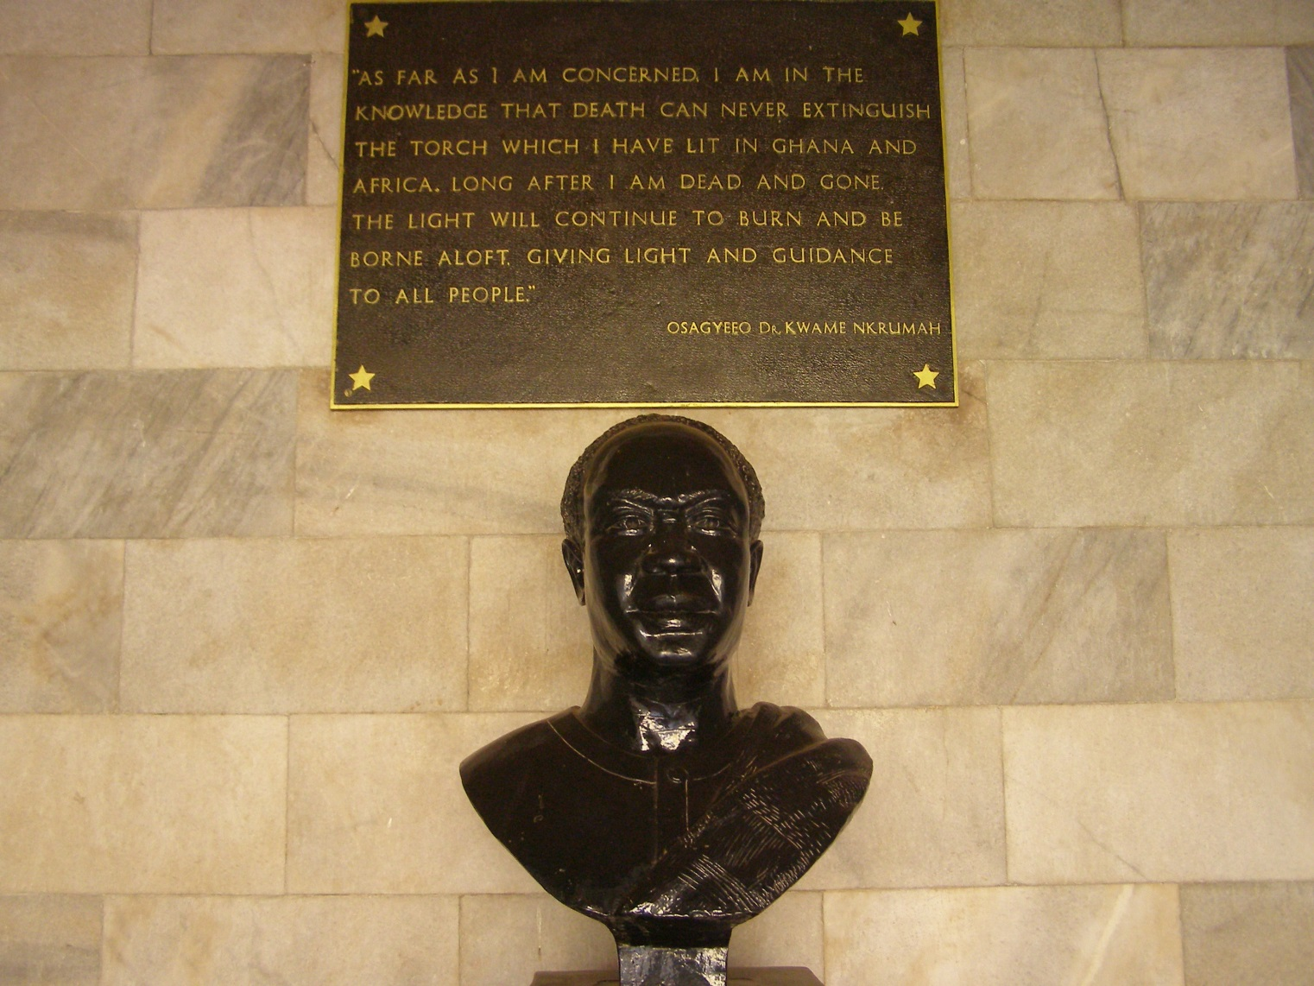
Kwame Nkrumah’s Birthplace

Slide 7
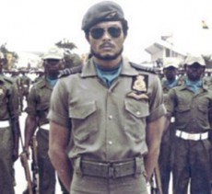
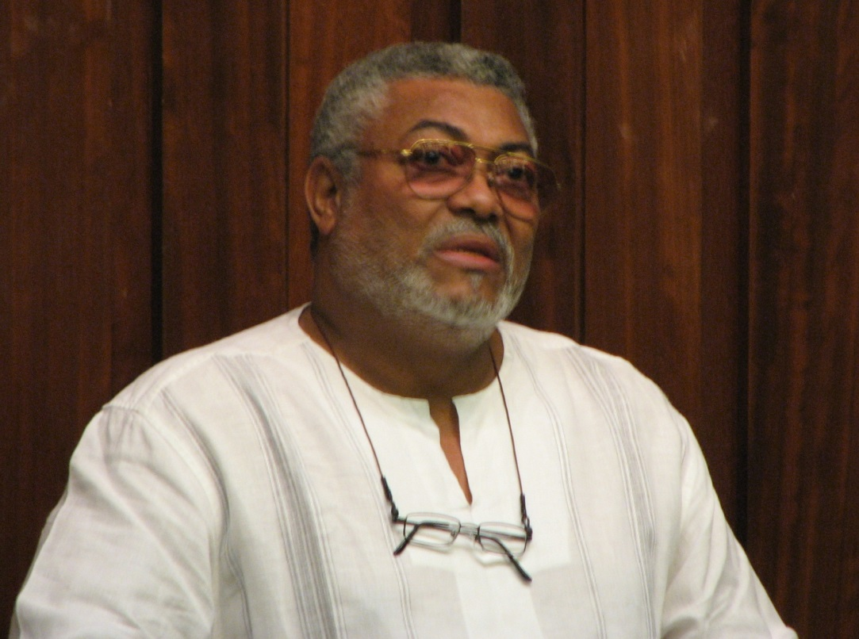
Jerry Rawlings, then and now

Slide 8
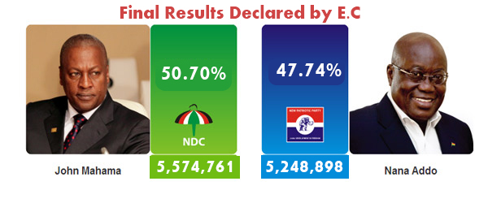
2012 Election Results

Slide 9
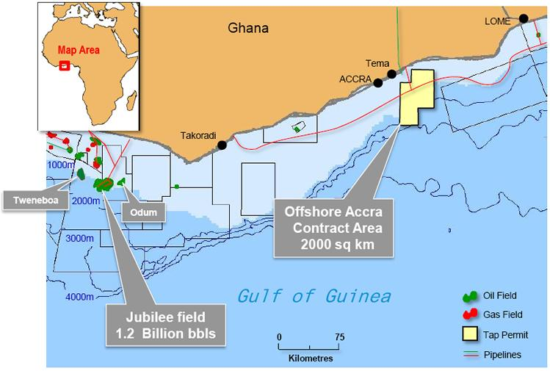
Oil in the water…

Slide 10
Preliminary Course Outline
Course title: “Ghana: The Challenges of Democracy and Development in Africa”
  Explore broader question of the challenges of building democracy and promoting development in Africa, through the case study of Ghana
  Cover the entire Independence period, but focus on contemporary developments
  Organized and led by Prof. Brown, but draw heavily on presentations by Ghanaian experts from academia, government and civil society
  Combine classroom presentations with field excursions and site visits
  First two weeks in national capital, Accra; last week in capital of Northern Region, Tamale
    Tamale portion of course focuses on issues of local government, rural development and regional inequality

Slide 11
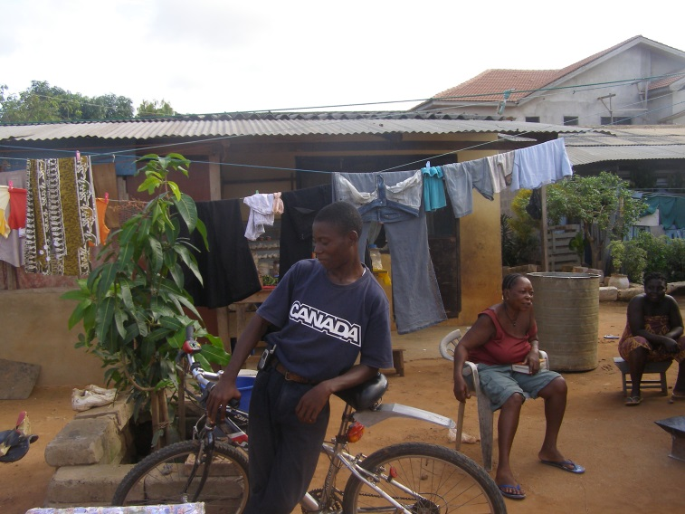
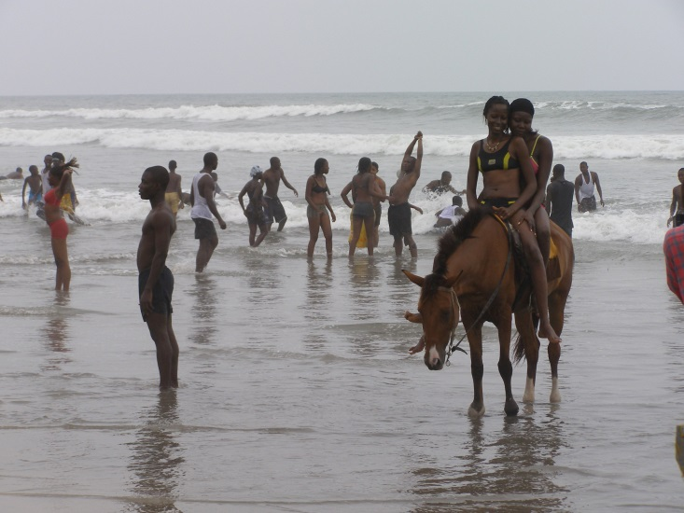
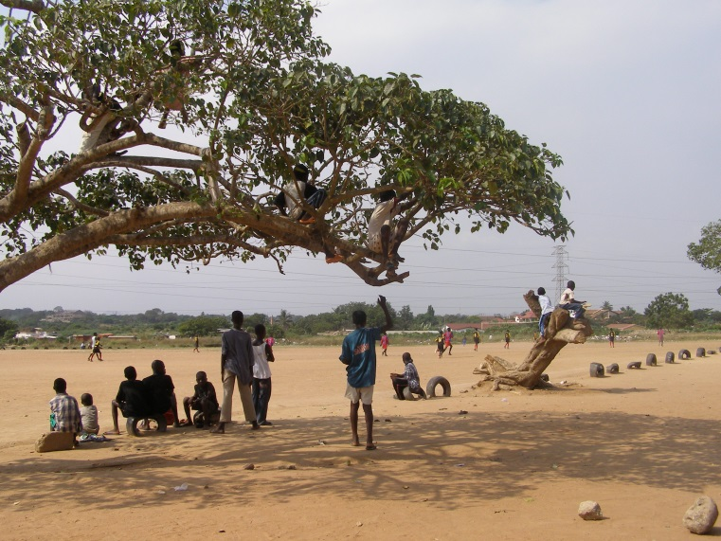
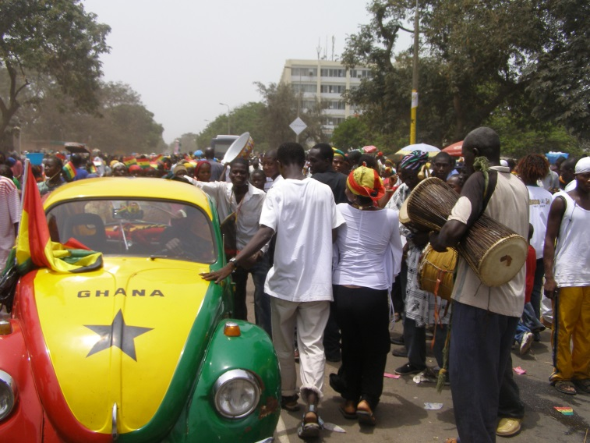
Images from Accra

Slide 12
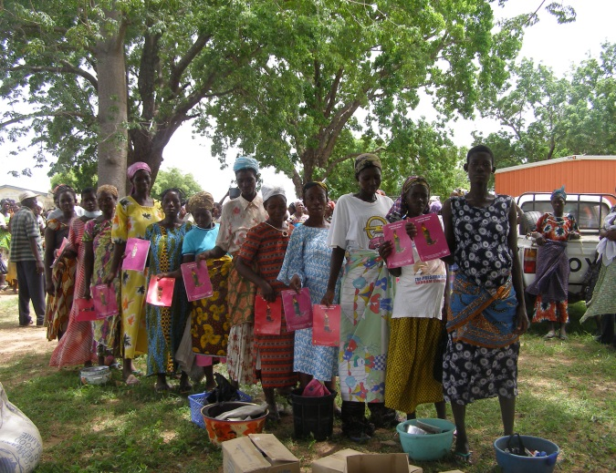
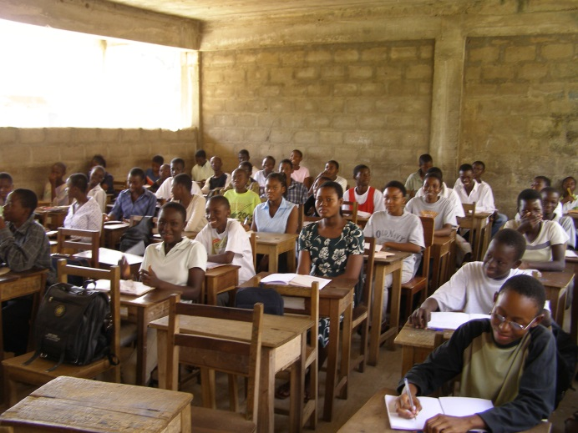
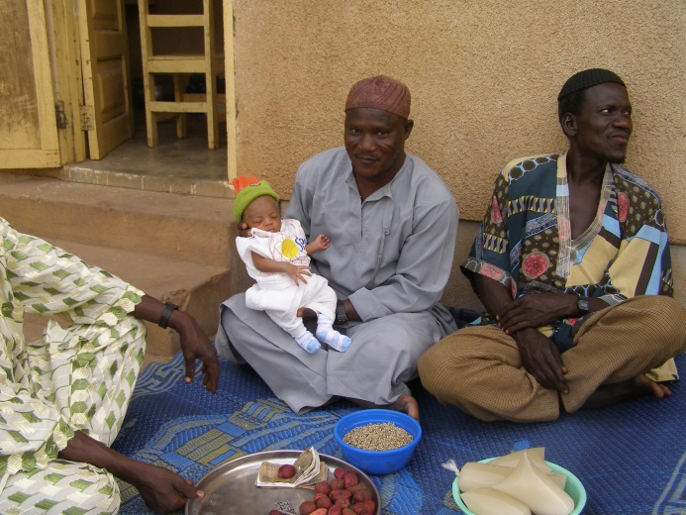
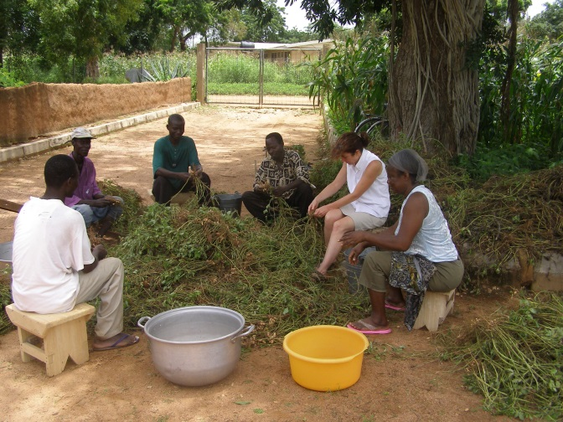
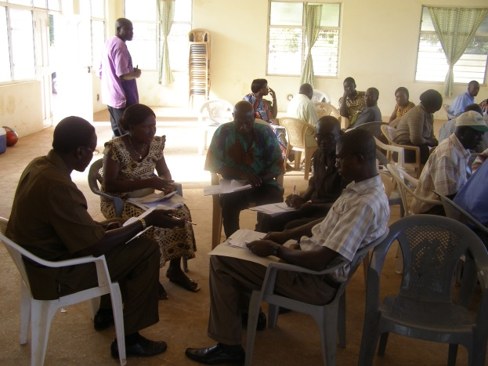
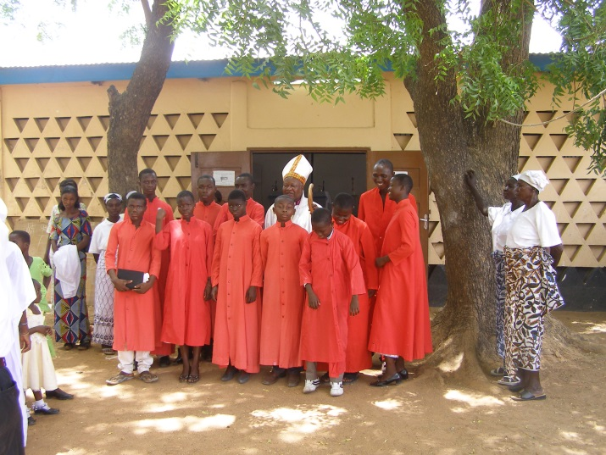
Images from the North

Slide 13
Course Requirements
It is a course, after all…
  Course pack, available beforehand, with all course readings
  Students will be expected to submit at least 10 reflection pieces of 1-2 pages each
  These reflection pieces may either be an academic discussion of a given daily topic and the associated guest speaker/excursion, or may be a personal reflection on some aspect of our stay in Ghana (e.g. reaction to our site visit to Cape Coast Castle)
  Your grade will be based on your best 10 reflection pieces, each weighted equally, with no more than 2 “personal” reflections included in the total

Slide 14
Possible Contributors and Expertise
Prof. Daniel Osabu-Kle, Carleton: traditional authorities
Dr. Sulley Gariba, Office of the President: national planning
Dr. Rasheed Draman, Africa Centre for Parliamentary Affairs, Parliament
Dr. Franklin Oduru, Ghana Centre for Democratic Development: democratization
Dr. Amanda Coffie, University of Ghana: migration and refugees
Prof. Joseph Yaro, University of Ghana: rural development
Dr Esther Ofei-Aboagye, Institute of Local Government Service: local government, gender
Mr Gregory Adoo, Principal Planning Officer, Northern Region

Slide 15
Logistics
Course dates: Monday, May 4 through Friday, May 22 inclusive
  Aim to arrive no later than May 2, free to depart any time from May 23 onward
  Most class days: Lecture/visit am, free pm
  Weekend of May 9/10: visit to Cape Coast and Kakum N.P.
Accommodation and ground transport provided
  Hope to partner with the Institute of Local Government Service, which has campuses in both Accra and Tamale, including boarding facilities
  Ground transport by bus (tro-tro) in Accra and to Cape Coast, air travel to Tamale

Slide 16
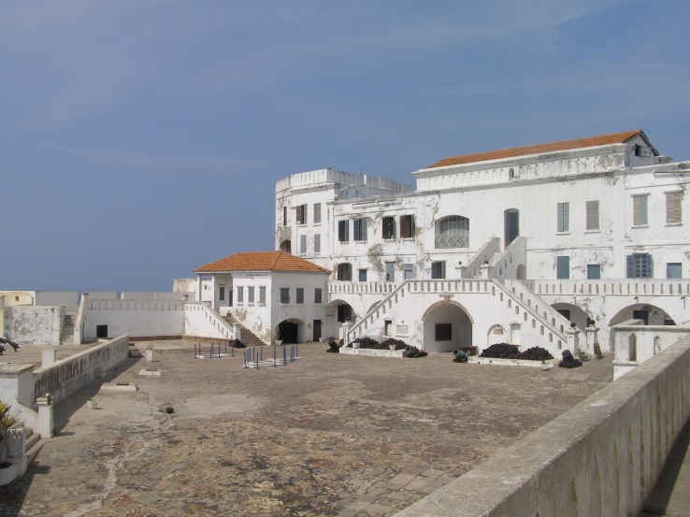
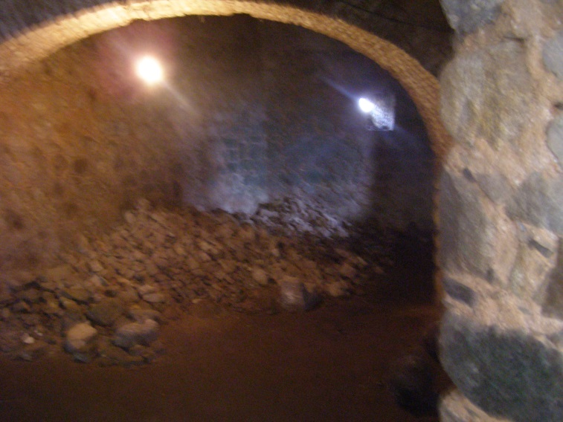
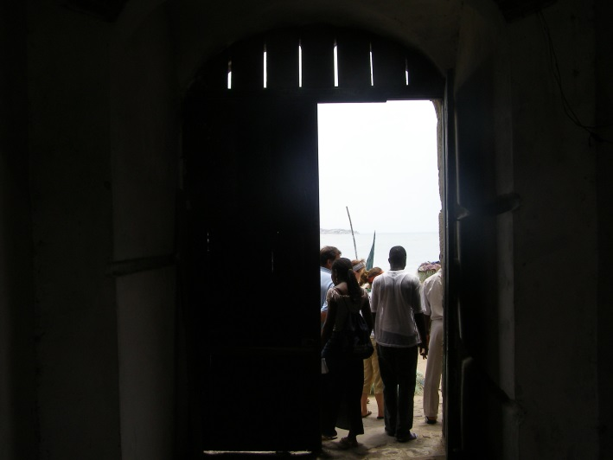
Cape Coast Castle

Slide 17

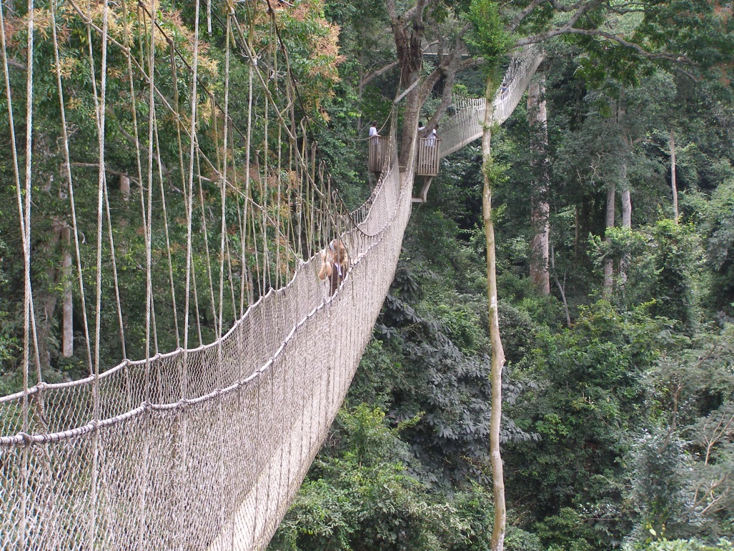
Kakum National Park

Slide 18
Budget
Still to be finalized, but expect that:
  Carleton will cover basic food, accommodation and in-country travel costs
  Students responsible for, all figures estimates:
    Tuition: $650
    Return air fare to Accra: $1,500
    Course pack: $100
    Vaccinations, anti-malarials: $250
    Ghana visa: $95
    Park fees: $50
    Approx. total non-tuition costs: $2,000
  Not included: spending money, gifts, extra food, personal travel

Slide 19
Applications
  Application form to be posted on IAS Website
  Application deadline: Nov. 1, 2014

Slide 20
Questions?

